Slide 1

Shortest Path 2: Path Algorithms
CSCI 39575 Graph Theory
By Ariel Avshalom

Slide 2
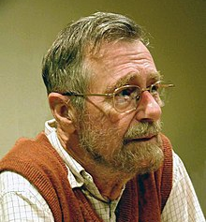
Who was Edsger Dijkstra?
One of the pioneers in computer science
He was a Dutch computer scientist (1930-2002) whose ideas greatly shaped computer science
He was known in complier construction, OS, distributed systems, algorithms and many other fields
He’s known for creating “structured computing” or the idea of control flow

Slide 3


Graph theory contributions
Dijkstra contributed many wonderful algorithms and research to the field of computer science
In graph theory, his best known contribution was the single source shortest path algorithm, otherwise known as Dijkstra’s Algorithm
This algorithm could find the shortest path from node N0 to any other node in the graph in at worst (using a priority queue):
$$Θ\left(E+N\right)Log\left(N\right) time.$$

Slide 4


Limitations
This algorithm works best in sparse graphs where adjacency lists are used as the data structure
This algorithm could take a worst case time of $Θ\left(\left|N^{2}\right|\right)Log(N)$ in the case of a dense graph approaching $N^{2}$ edges
The algorithm won’t be correct if there are negative edges in the graph

Slide 5

The algorithm: material needed
Given a graph, and a starting node N0 create
An empty set that keeps track of shortest path nodes
A set of node distances initialized with 0 as the starting node distance and infinity for all other nodes

Slide 6

The algorithm: pseudocode
While your set of nodes != the nodes in the graph
Pick the nearest vertex which is not in the set of nodes
Append it to the set of nodes
Update the cost of the node in your node distances set
It sounds simple, but depending on the data structure used it could be pretty complicated

Slide 7
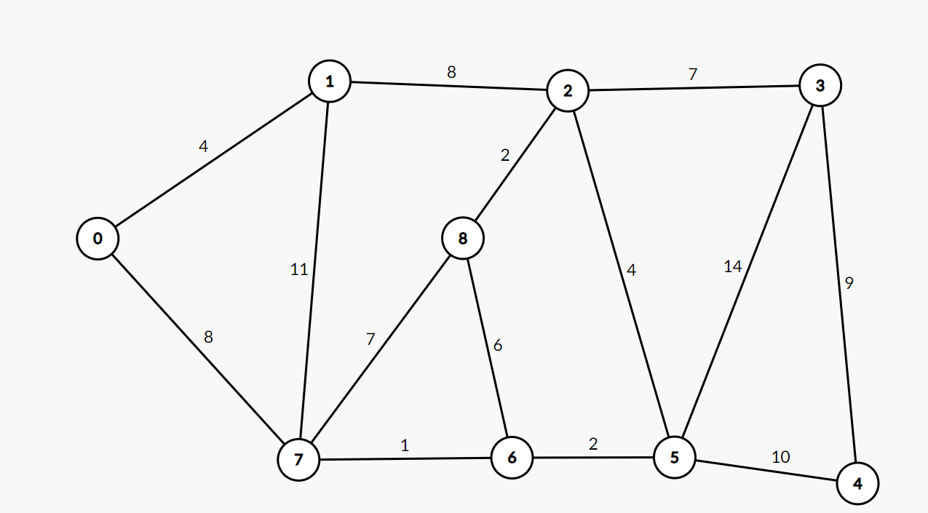
An example: Single shortest path on this graph (see OneNote)

Slide 8
Using a priority queue
A priority queue is a great modification to this algorithm that might help in the case of graphs with many nodes
Computerphile has a great video on it

Slide 9
Other algorithms to explore

Slide 10
Finding the single source shortest path

